Slide 1
Multimodal seas in WEC-Sim
Sal.Husain@nrel.gov

Slide 2
Modifications to the current source code
Superpositioning wave spectra a priori while still maintaining their unique properties,
Programmatically generating the corresponding excitation force vector for each contributing wave-spectra,
Programmatically animating each contributing wave spectrum, and simultaneously displaying them with the WEC dynamics.

Slide 3
Superpositioning wave spectra
Each wave train is described as a new instance of the waves#() object, where # represents the index of the wave train being represented.
A new function waveGen(waves#() object) is then used to generate the time history for each wave train which is then used in the Simulink model.
Each waves#() object is stacked in the variable waveGroup which the Simulink model then extracts and programmatically populates the relevant blocks corresponding to each wave train.

Slide 4
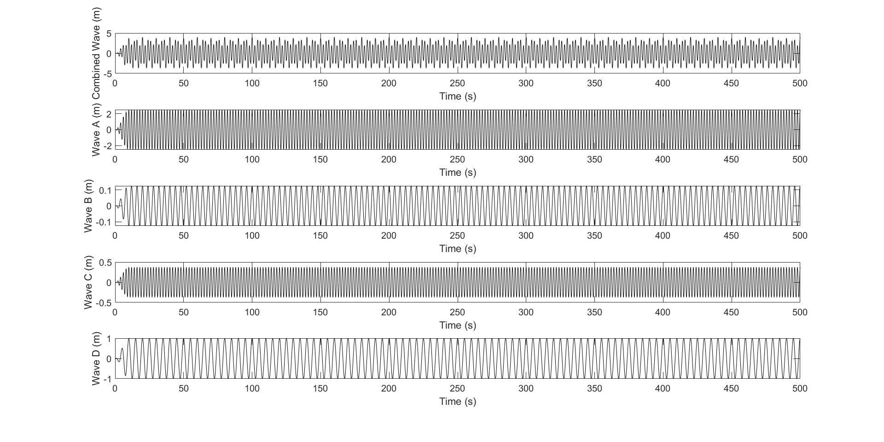
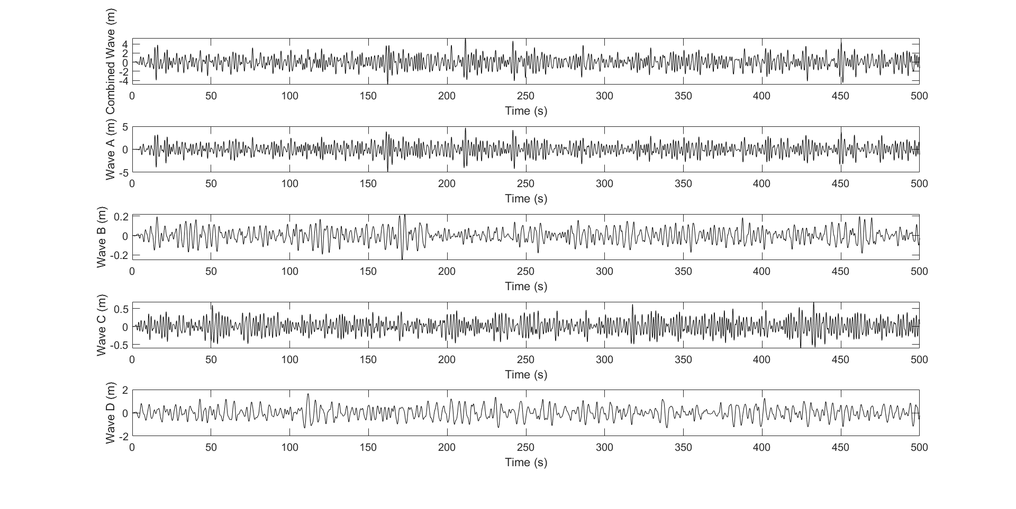
Superpositioning wave spectra

Slide 5
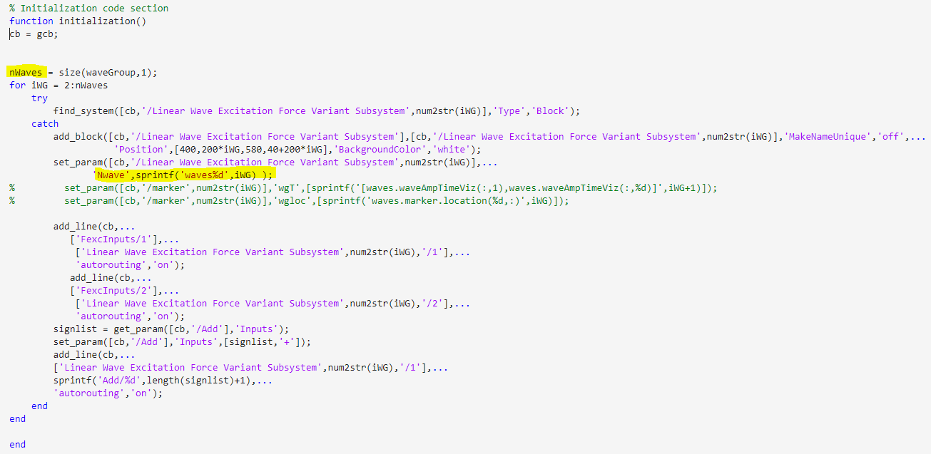
Generating excitation force blocks

Slide 6
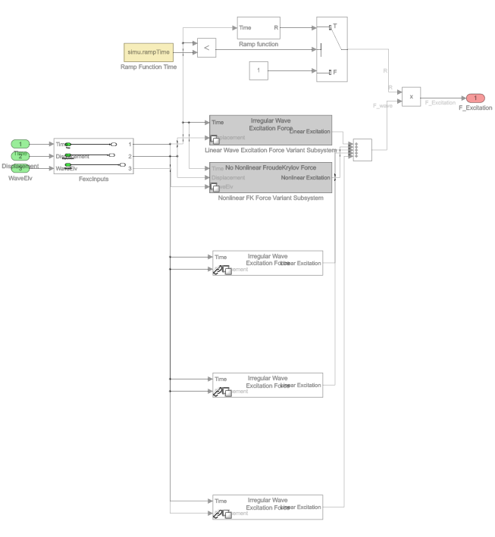

Slide 7
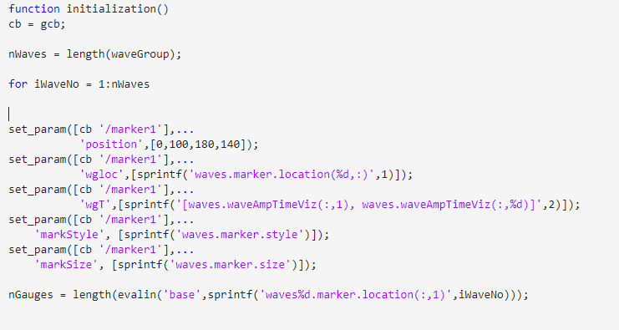
Animating multi-modal sea states along with WEC dynamics

Slide 8
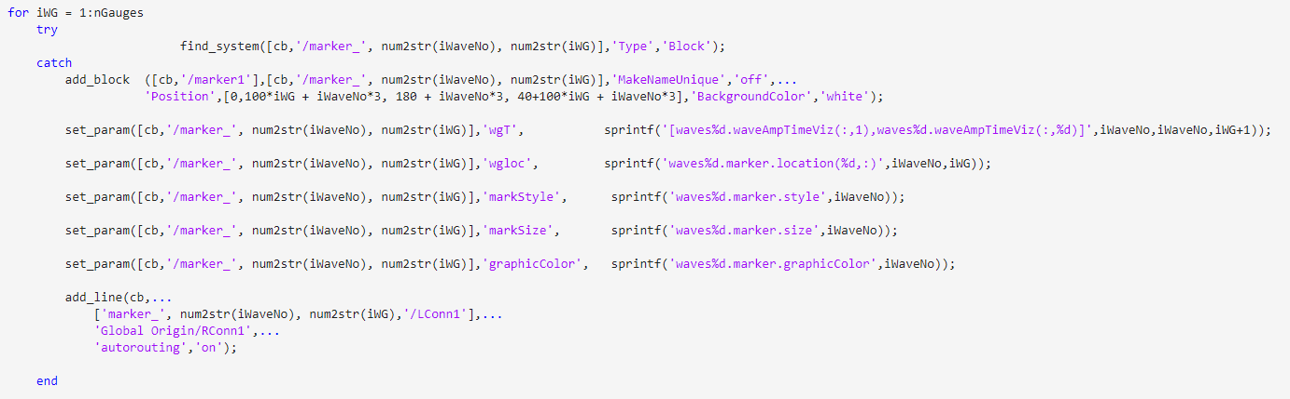
Animating multi-modal sea states along with WEC dynamics

Slide 9
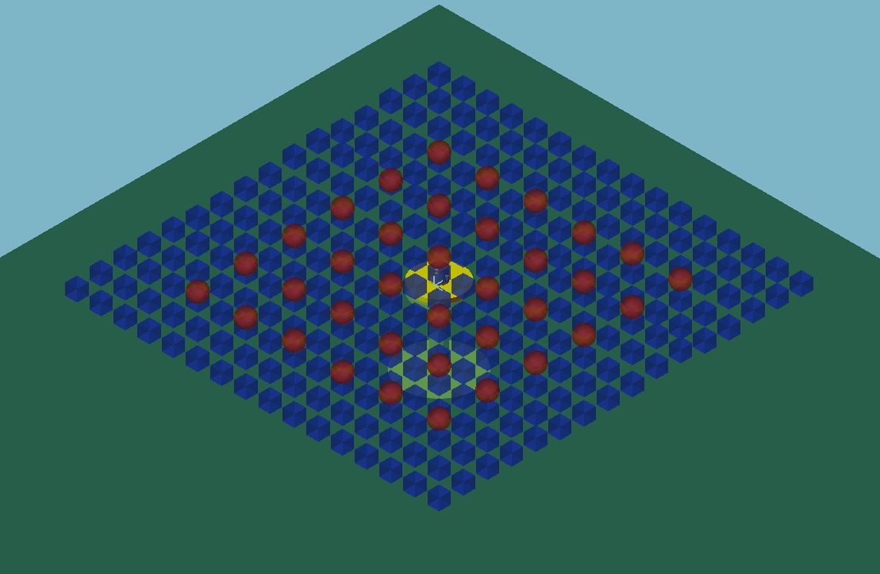
Animating multi-modal sea states along with WEC dynamics

Slide 10
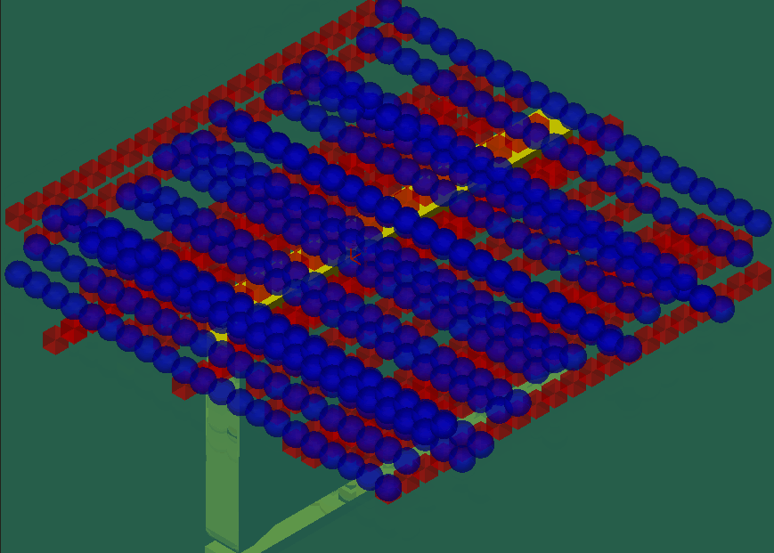
Animating multi-modal sea states along with WEC dynamics

